Slide 1
School of Engineering and technology
Department of Computer Science and Engineering
Arduino Project
on
CLAP SWITCH SYSTEM
Team Members
Project Guide
Sanjay E – 22BBTCS262
Sanket Wali – 22BBTCS263
Prof. Akshatha Bhat
Assistant Professor
Dept. of ECE
SOET, CMRU, Bangalore
Date: 29 / 12/ 2023

Slide 2
Outline
Abstract
Introduction
Objective
Methodology
Hardware Description
Software Used
Advantages
Application
Conclusion
References

Slide 3
Abstract
The Clap Switch project uses Arduino to create a hands-free control system for electrical appliances, aiming to be both innovative and practical. The system consists of a sound sensor, Arduino board, and relay module. The sound sensor captures audio from outside, identifying specific clap patterns that are then analyzed by Arduino. The relay module determines whether the power supply to connected appliances should be switched off or on based on the user's clapping sequence. This system is energy-efficient and easy-to-use, providing convenience. The Clap Switch project aligns with the growing popularity of smart homes, making it affordable for those wanting their homes automated. There are no complex procedures involved, making it an entry-level demonstration for integrating Arduino technology into daily life. This project promotes innovation and simplicity in residential automation systems at large scales, aligning with the growing trend of smart homes.

Slide 4
Introduction
The field of electronics and automation is full of surprises. It is amazing how we can actually control our gadgets by just waving at them or talking to them. One such project that has made people wonder is called “Clap Switch” which uses Arduino, a no touch way of switching on and off any electronic gadget.
The concept behind the Clap Switch is very simple but it works perfectly well. It uses sound recognition to turn lights ON/OFF, operate different appliances, etc., based on patterns of claps produced by the user. This is one example where Arduino, an open-source electronics platform, has been used in creating innovative applications thus showing how convenient DIY(Do-It-Yourself) electronics are nowadays.

Slide 5
Objective
Sensitivity and Accuracy: - Develop a clap detection algorithm that ensures accurate and reliable recognition of clapping sounds while minimizing false triggers from ambient noise.
User-Friendly Interface: - Create a user-friendly interface that allows users to easily configure sensitivity levels and set up the clap switch for various applications.
Compatibility: - Ensure compatibility with a range of electronic devices, such as lights or fans, by integrating the clap switch system with Arduino-based relay modules.
Energy Efficiency: - Implement power-efficient mechanisms to minimize energy consumption when the clap switch is in standby mode, contributing to overall energy conservation.
Expandability: - Design the system with the potential for future expansion, allowing users to integrate additional features or connect the clap switch to other smart home automation platforms.
6.Documentation and Instructions:- Provide comprehensive documentation, including a user manual and step-by-step instructions for assembling, configuring, and using the clap switch system.
7.Safety Considerations:- Incorporate safety features to prevent unintended activation or deactivation of devices, especially in scenarios where false triggers could have undesirable consequences.
8.Educational Outreach:- Develop educational materials or tutorials to promote understanding and engagement with the project, making it accessible to individuals with varying levels of technical expertise,
9.Open Source Collaboration:- Encourage open-source collaboration by sharing the project's source code, schematics, and design files, fostering a community of developers and enthusiasts who can contribute to its improvement.
10.Feedback and Iteration:- Collect user feedback and iterate on the design based on practical experiences and suggestions, aiming to continually enhance the clap switch system's performance and usability.

Slide 6
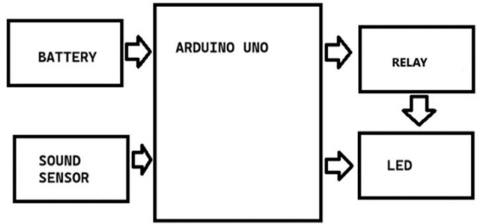
Methodology

Slide 7
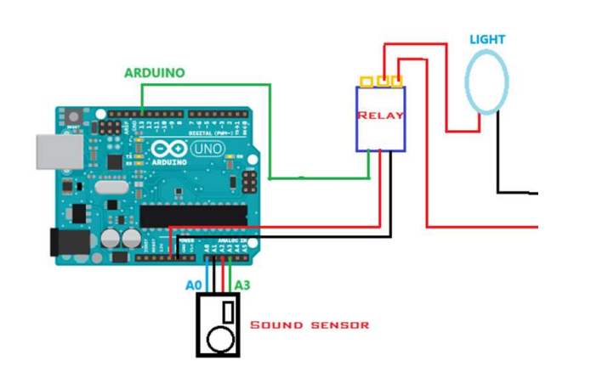
Hardware description
A clap switch system is a simple electronic device that enables control of electrical appliances through sound detection, specifically by clapping. It consists of a microphone or sound sensor as an input component, an amplifier to boost the signal, a signal processing unit to interpret the sound pattern (such as a microcontroller or dedicated circuitry), and a relay or switch to control the connected electrical load.
When the system detects a predefined sound pattern, typically a sequence of claps, the microphone captures the sound waves, which are then amplified and processed to identify the specific sequence. Once recognized, the processing unit triggers the relay or switch, completing the circuit and turning the connected device on or off accordingly.
The design requires careful consideration of sensitivity adjustments and noise filtering to accurately detect the clapping pattern while minimizing false triggers. It's often used for home automation, offering a convenient hands-free method to control lighting, fans, or other electrical appliances.

Slide 8
Software Used
For an Arduino project involving a dancing robot with the ability to walk and avoid obstacles the Arduino IDE (Integrated Development Environment) serves as the primary platform for writing, compiling, and uploading code to the Arduino board. Within the IDE, we can leverage the C/C++ programming language to create algorithms that would control the robot's movements.

Slide 9
Advantages
Ease of Use: It requires only a sound (clap) for the operation of the connected electrical device on or off.
Convenience: They provide a hands-free way of controlling lights, fans, or other electrical appliances, enhancing convenience, especially in situations where hands might be occupied.
Energy Efficiency: Clap switches can contribute to energy conservation by allowing users to easily turn off lights or devices with a simple clap, reducing unnecessary power consumption.
Accessibility: These switches can be particularly useful for individuals with mobility issues or disabilities, offering a convenient way to control appliances without needing physical contact with the switch.
Novelty and Innovation: They represent a novel and innovative way of controlling devices, adding a touch of modernity and uniqueness to the home or workspace.

Slide 10
Application
1.Assistive Technology: People who have difficulty moving (such as those with physical disabiliƟes) can use claps to control devices.
2.Interactive Public Installations: Public spaces, museums and community events should be places where interactive exhibits or displays can be found.
3.Community Gatherings: Clap controls for lighting or decorations can bring about interactivity and fun in parties or events.
4.Educational Workshops: Introduce electronics and programming through STEM workshops that are conducted in schools or community centers.
5.Energy Conservation Campaigns: Electricity management and conservation can be simplified by using clap-based controls.
6.Public Spaces Accessibility: Accessible public spaces should have clap-controlled features like lighting among others to assist people living with disabilities.
7.Cultural and Artistic Events: Clap-controlled elements for audience interaction can be added to cultural performances or art displays.
8.Senior Citizen Support: Clap controls in their living spaces may help elderly people do things more easily.
9.Community Innovation Challenges: Residents should be challenged to invent new Clap Switch applications in the neighborhood.
10.Communication Aid: Non-verbal individuals might consider using clap patterns as a way to communicate.

Slide 11
Conclusion
The Arduino Uno clap switch project is a hands-free electronics and microcontroller programming application that integrates a microphone and uses carefully cracked code. It allows hands-free control of electronic devices through clapping sounds, making it an excellent introductory project for sensor integration, signal processing, and digital output control. The project's versatility is enhanced by fine-tuning sensitivity settings, making it suitable for various environments. Overall, it serves as an educational and interactive endeavor in DIY electronics.

Slide 12
Reference
[1] https://www.electronicsforu.com/
[2] https://wokwi.com/
[3] https://www.tinkercad.com
[4] https://www.youtube.com/user/arduinoteam
[5] https://github.com/topics/arduino
[6] https://forum.arduino.cc/

Slide 13
THANK YOU

